Slide 1

SKIN TONE SEGMENTATION AND FINGER TIP DETECTION
Presented by, Guided by,
Vishal Vijayan(11010598) Prof Dr Ing Christof Jonietz
Dept. of Information Technology Dept. of Information Technology
SRH Hochschule Heidelberg SRH Hochschule Heidelberg

Slide 2
Content
Introduction
Steps for Fingertip detection
Color spaces
HSV
Implementation
Results

Slide 3
Introduction
Image processing is a method to perform some operations on an image, in order to get an enhanced image or to extract some useful information from it.
Fingertip detection is very popular and effective way used for human machine communication
It has been used in many applications including embedded systems, vision based systems and medical applications.
We are focusing on fingertip detection of natural hand with real time performance.

Slide 4
Steps for finger tip detection
Segmenting the hand skin
Color space
HSV
Median blur
Dilate
Finding contour
Fingertip detection
Convex hull

Slide 5
Color spaces
RGB
HSV/ HSL
YCbCr
CIE
CMYK
For our project we are using RGB and HSV.

Slide 6
Hue Saturation Value (HSV) Color Model
H- Hue (the color information),
S -saturation (the percentage of ‘color’ present)
V- value/brightness(the percentage of ‘white’ color present).
For color segmenting HSV is better(dissociated from the information of illumination.)
Generally, human skin lies between (H=0,S=58) and (H=50,S=173).

Slide 7
Implementation
Read image from the webcam.
we are getting a frame from the camera each 30 milliseconds
cvtColor(CV_BGR2HSV) is used for this operation.
To remove isolated dots we need to apply median blur and dilate to fill holes.
OpenCV’s function findContours to get the contours of all objects in the image.
To detect Fingertip, Convex hull technique is used.

Slide 8
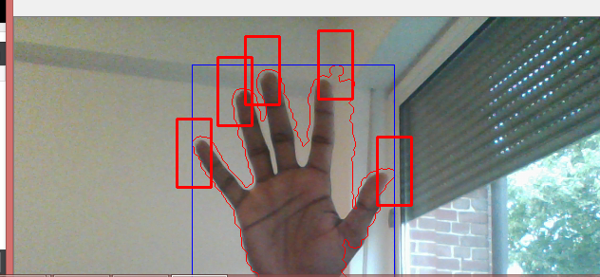
Results
Results obtained is shown as below

